Slide 1
Progress Details for Bulk Jobs
Yoel Kortick
Yoel.Kortick@clarivate.com

Slide 2
Agenda
  Introduction
  Job Stages and Jobs Queue
  Job Progress Details – a live example (part 1 of 4)
  Job Progress Details – a live example (part 2 of 4)
  Job Progress Details – a live example (part 3 of 4)
  Job Progress Details – a live example (part 4 of 4)
  Job Complete

Slide 3
Introduction

Slide 4
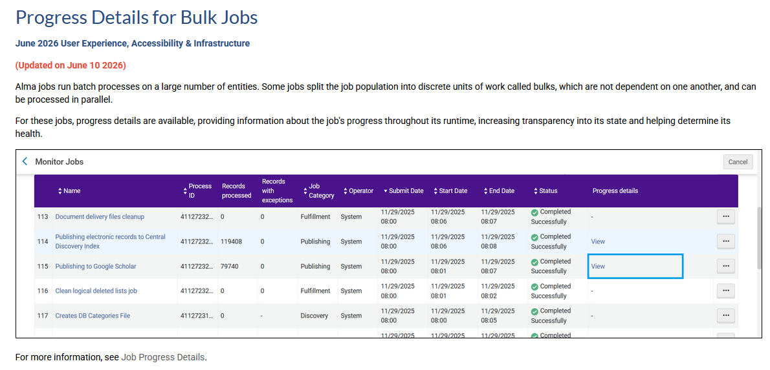
Introduction
From the Alma June 2026 Release Notes

Slide 5
Introduction
In addition to this presentation see also the online help for Job Progress Details.
For the June 2026 Alma release major improvements were made regarding the efficiency and transparency of how jobs in Alma run.
This has resulted in
  A significant decrease in the time it takes for jobs to complete.
  The ability to view the progress of a job in real-time.
In this presentation we will look at the progress of a job in several stages from start to finish using this powerful new feature.

Slide 6
Introduction
Some Alma Jobs run batch processes on a large number of entities.
For example
  The job "Authorities - Preferred Term Correction" works on a large number of bibliographic headings and updates them as necessary according to the linked authority headings
  The job "PO Line – Claiming" works on a large number of PO Lines and updates them according to the receiving status of the ordered physical item or activation states of the ordered electronic resource.
  The job "Notifications - Send Courtesy Notices and Handle Loan Renewals" works on a large number of loans and updates them according to the due date and predefined parameters.

Slide 7
Introduction
When some of these batch processes run, they split the job population into discrete units of work called "bulks".
These "bulks" are
  Not dependent on one another
  Can be processed in parallel.

Slide 8
Introduction
For example, using the examples from a previous slide here:
  The job "Authorities - Preferred Term Correction" can work on "bulks" of headings simultaneously rather than working on one heading at a time
  The job "PO Line – Claiming" can work on "bulks" of PO Lines simultaneously rather than working on one PO Line at a time
  The job "Notifications - Send Courtesy Notices and Handle Loan Renewals" can work on "bulks" of loans simultaneously rather than working on one loan at a time

Slide 9
Introduction
Information regarding the Job Progress details are available for jobs that run in bulks
The progress details provide information about the progress of the job over its entire runtime.
  These "progress details" will focus on in this presentation
The availabilty of the information regarding the Job Progress details:
  Increases transparency regarding the job’s state
  Assists in determining the job’s performance.

Slide 10
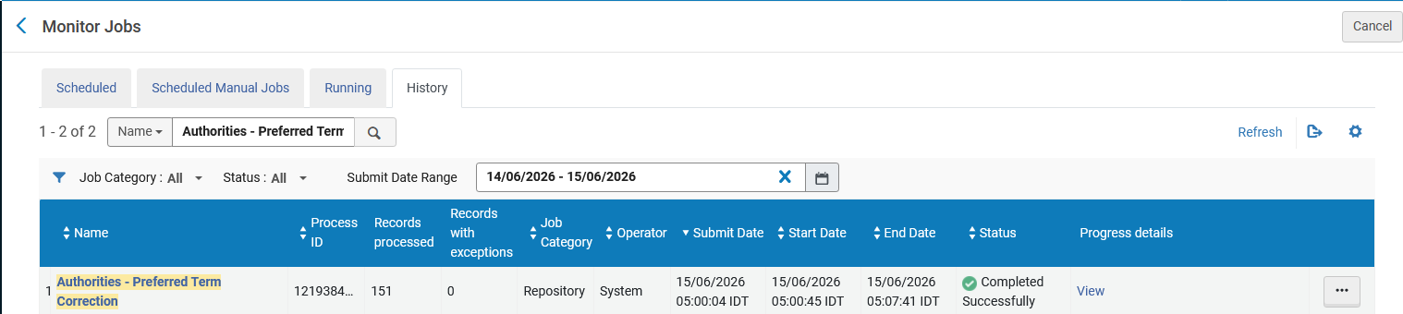
Introduction
Job Progress details can be seen from "Admin > Manage Jobs and > Monitor Jobs" in both the "Running" and "History" tab.
Soon we will click to see what the "Progress details" includes.

Slide 11
Job Stages and Jobs Queue

Slide 12
Job Stages and Jobs Queue
There are four stages to the running of a job:
Pending — A submitted job waiting to be triggered by Alma.
  If no available system resources exist, the job remains in Pending status until system resources become available.
Initialization — When started, a job begins with the initialization stage.
  The operations performed during the initialization stage vary between job types.
  For jobs that work with bulks, bulks are created during the initialization stage.
Processing — The main job stage during which the job’s work is done.
Finalization — Before the job ends, the finalization stage is run.
  The operations performed during the finalization stage vary between job types.

Slide 13
Job Stages and Jobs Queue
As stated in a previous slide, bulks are created during job initialization.
The bulks are initially assigned the "Waiting for processing" status.
Bulks in the waiting list are periodically moved to the queue in a process called a "Round".
  A job cannot exceed the maximum allowed number of bulks in the queue at a time.
  A job "Round" moves the maximum number of bulks to the queue without exceeding the limit.
Bulks are processed from the Jobs Queue.
  Alma continuously optimizes and prioritizes running jobs to allocate resources effectively.
  Bulks of jobs assigned a higher priority may be processed before bulks of jobs with lower priority.

Slide 14
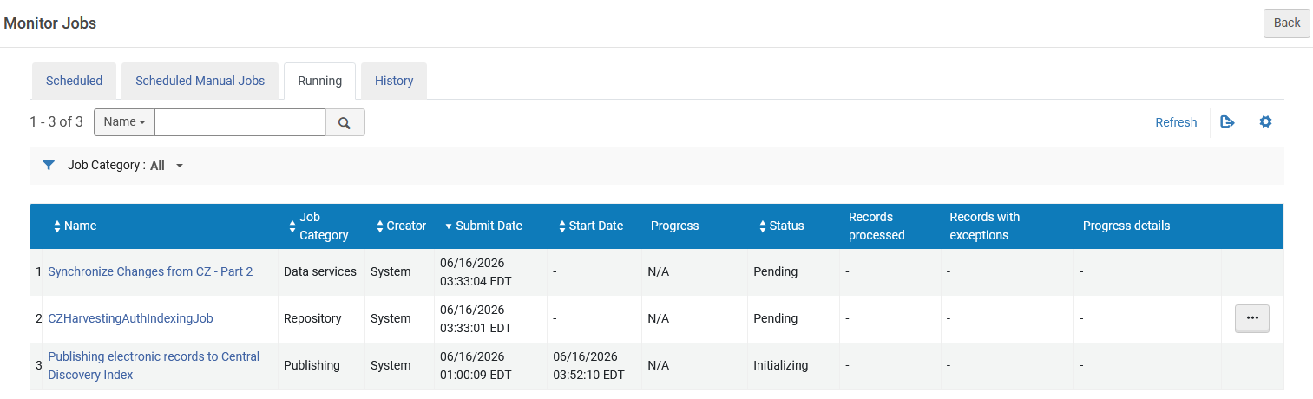
Job Stages and Jobs Queue
Here we see examples of the "Pending" and "Initializing"

Slide 15
Job Progress Details – a live example (part 1 of 4)

Slide 16
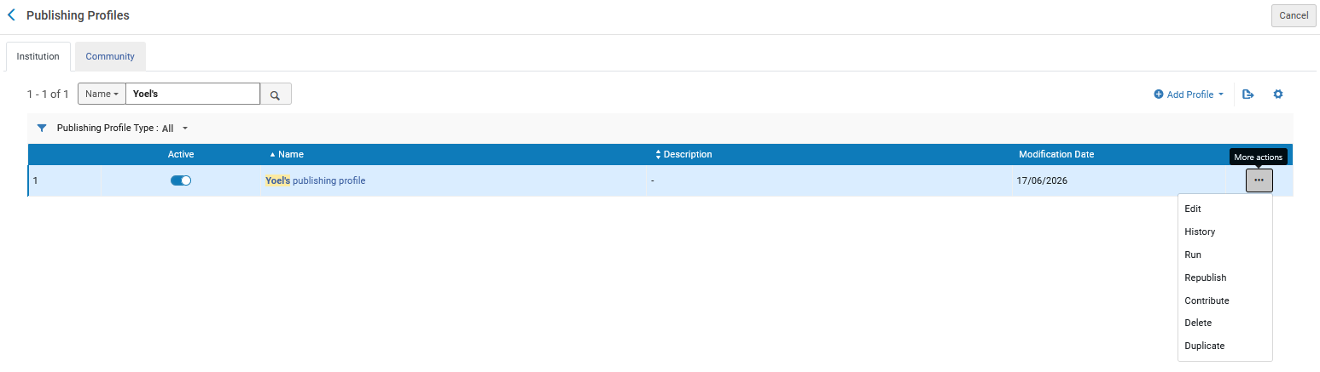
Job Progress Details – a live example (part 1 of 4)
A job is sent. In this case it is a publishing profile.

Slide 17
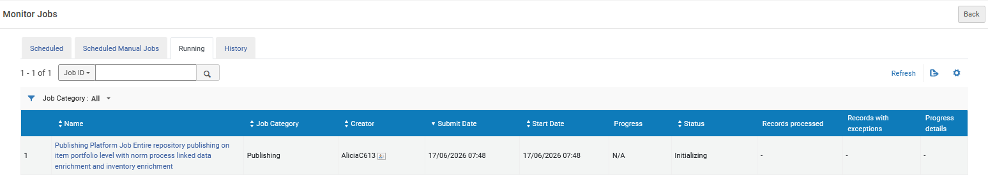
Job Progress Details – a live example (part 1 of 4)
When viewing the jobs via "Admin > Manage Jobs and Sets > Monitor Jobs" we see the job in the "Running" tab in status "Initializing".
If there were no resources at the current time, or if this job were dependent on another job, then the status would have been "Pending".

Slide 18
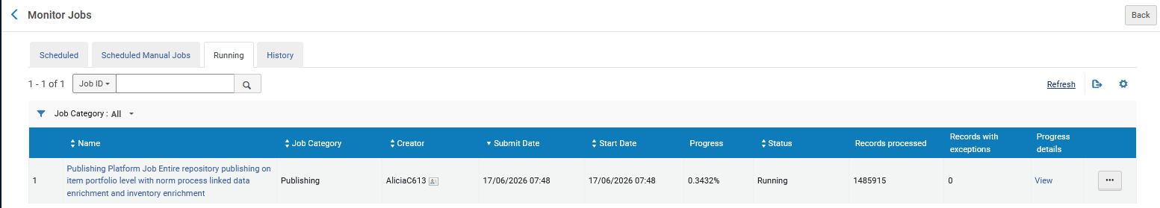
Job Progress Details – a live example (part 1 of 4)
Shortly thereafter the status changes from "Initializing " to "Running" and we have a link to "View" the "Progress Details". The job is now at progress of 0.3432%
We will click "View" in the "Progress details" column
The job is now at progress of 0.3432%
We will click here

Slide 19
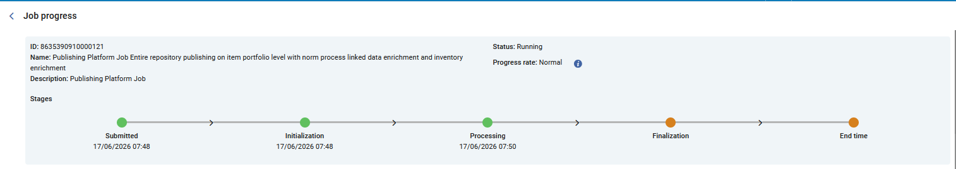
Job Progress Details – a live example (part 1 of 4)
Now we will see what is shown to the staff user after clicking "View" in the "Profess details" column on the previous slide.
We see that the job has passed the stages "Submitted" and "Initialization and is now at the stage of "Processing"
Completed these two stages
Now at the stage of "Processing"
These are future stages

Slide 20

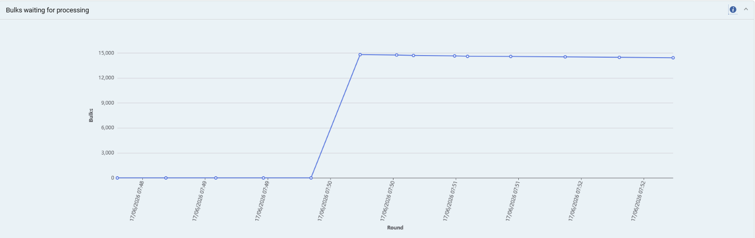
Job Progress Details – a live example (part 1 of 4)
We also see the "Bulks waiting for processing". This is the number of bulks waiting to be processed over the run time of the job.
We expect to see a steady decline in the number of waiting bulks.

Slide 21

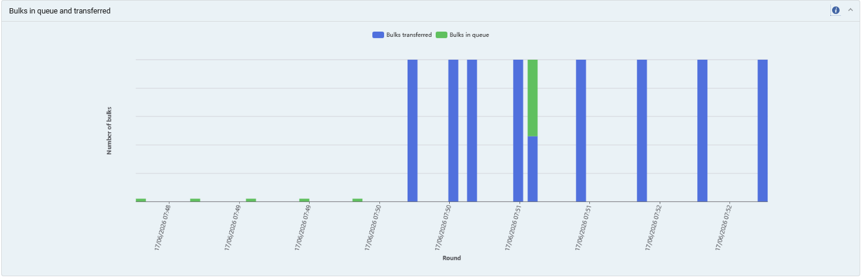
Job Progress Details – a live example (part 1 of 4)
We also see the Bulks in queue and transferred.
This includes the number of bulks still in the queue and the number of bulks transferred into the queue.

Slide 22
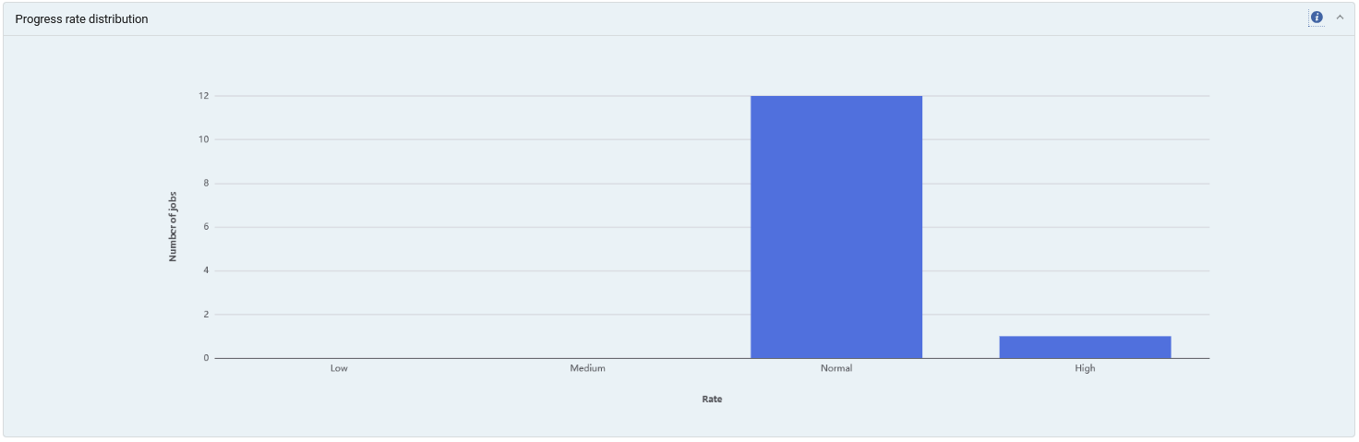

Job Progress Details – a live example (part 1 of 4)
We also see the Progress rate distribution.
This is the progress rate distribution for jobs of the same type from the past 3 months.
12 Normal and 1 High

Slide 23
Job Progress Details – a live example (part 2 of 4)

Slide 24
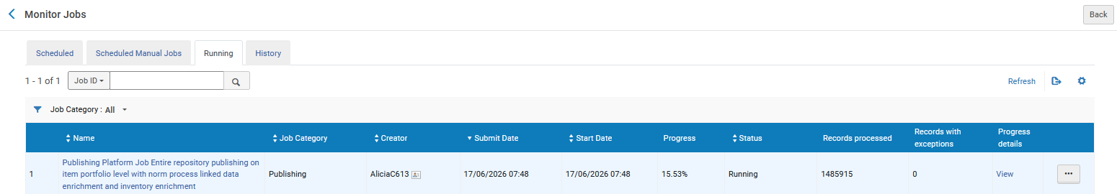
Job Progress Details – a live example (part 2 of 4)
Now we see that the job has progressed from 0.3432% to 15.53%
The job is now at progress of 15.53%
Now we will again click "View" and see the progress.

Slide 25
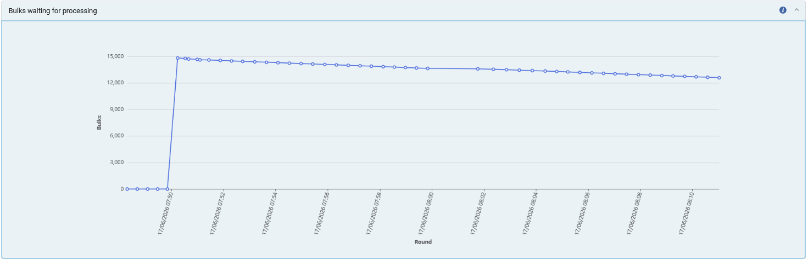
Job Progress Details – a live example (part 2 of 4)
"Bulks Waiting for Processing" before and after
Job at .3432%
A beautiful "steady decline".
Job at 15.53%

Slide 26
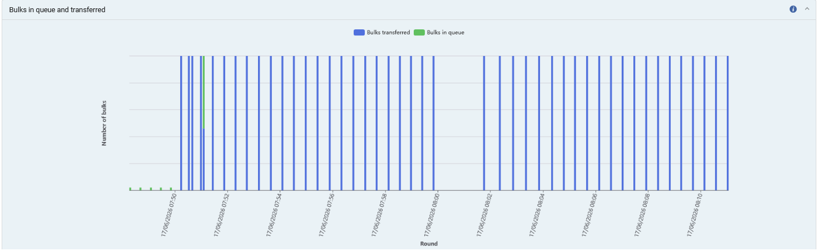
Job Progress Details – a live example (part 2 of 4)
"Bulks in queue and transferred" before and after
Job at .3432%
Previously there were many bulks still in queue.
The vast majority of the bulks have been transferred. We now see only one which was in queue.
Job at 15.53%

Slide 27
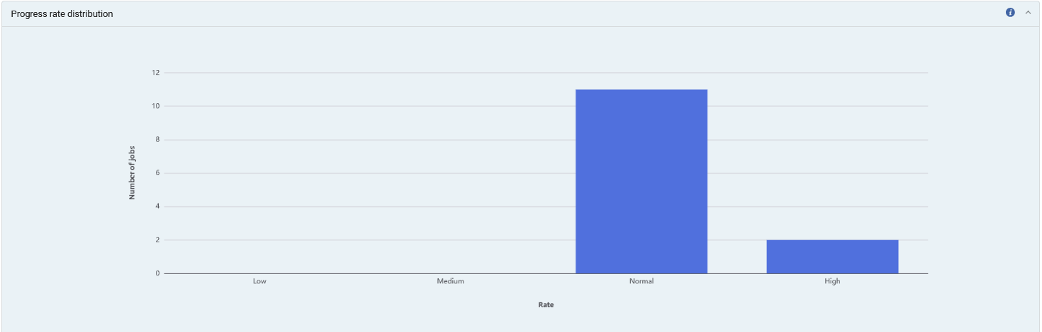
Job Progress Details – a live example (part 2 of 4)
"Progress rate distribution" before and after
Job at .3432%
The "Normal" decreased and has moved from 12 to 11 (number of jobs).
The "High" increased and has moved from 1 to 2.
Job at 15.53%
11 Normal and 2 High

Slide 28
Job Progress Details – a live example (part 3 of 4)

Slide 29
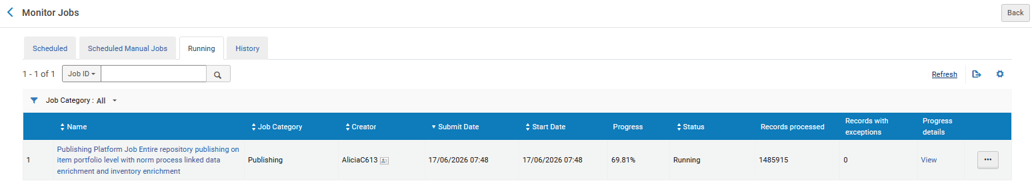
Job Progress Details – a live example (part 3 of 4)
Now we see that the job has progressed from 15.53% to 69.81%
The job is now at progress of 69.81%
Now we will again click "View" and see the progress.

Slide 30
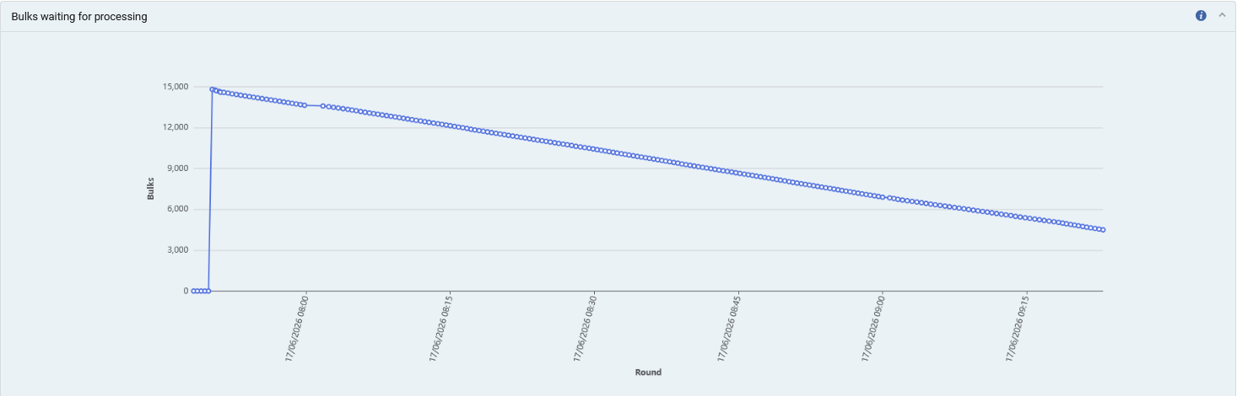
Job Progress Details – a live example (part 3 of 4)
"Bulks Waiting for Processing" before and after
Job at 15.53%
A beautiful "steady decline".
Job at 69.81

Slide 31
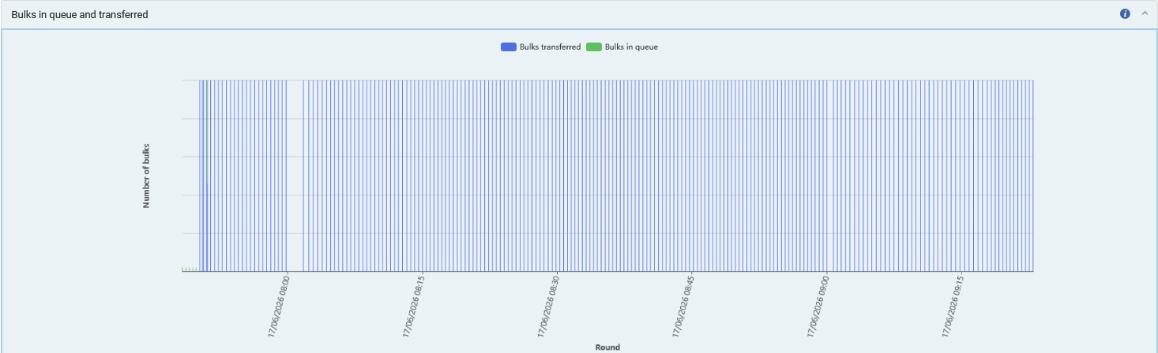
Job Progress Details – a live example (part 3 of 4)
"Bulks in queue and transferred" before and after
Job at 15.53%
The vast majority of the bulks have been transferred. We now see only one which was in queue.
We see that the number of transferred bulks has greatly increased.
Job at 69.81

Slide 32

Job Progress Details – a live example (part 3 of 4)
"Progress rate distribution" before and after
Job at 15.53%
Job at 69.81
11 Normal and 2 High
No change here

Slide 33
Job Progress Details – a live example (part 4 of 4)

Slide 34
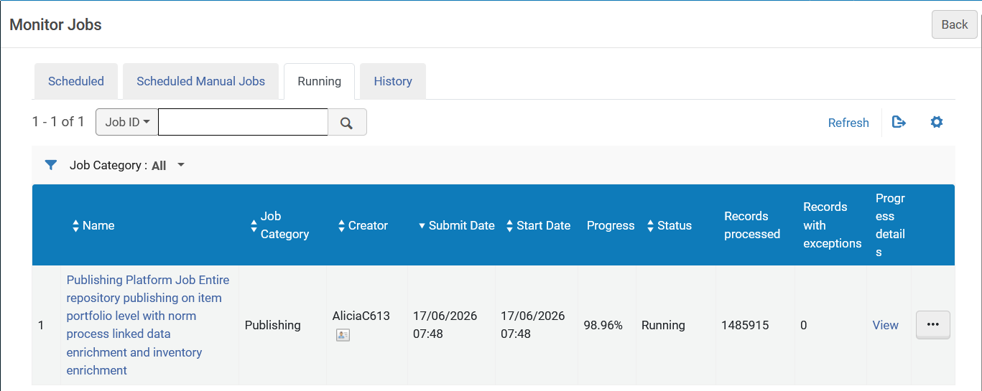
Job Progress Details – a live example (part 4 of 4)
Now we see that the job has progressed from 69.81% to 98.96%
The job is now at progress of 98.96%
Now we will again click "View" and see the progress.

Slide 35
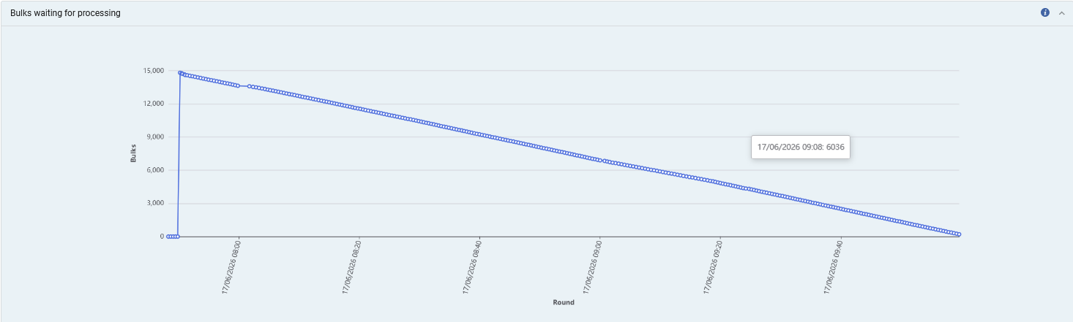
Job Progress Details – a live example (part 4 of 4)
"Bulks Waiting for Processing" before and after
Job at 69.81%
Job at 98.96%
A beautiful "steady decline" to 0.

Slide 36
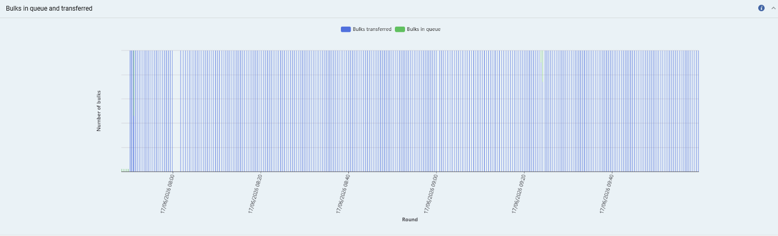
Job Progress Details – a live example (part 4 of 4)
"Bulks in queue and transferred" before and after
Job at 69.81%
The vast majority of the bulks have been transferred. We now see only one which was in queue.
We see that the number of transferred bulks has greatly increased.
Job at 98.96%

Slide 37
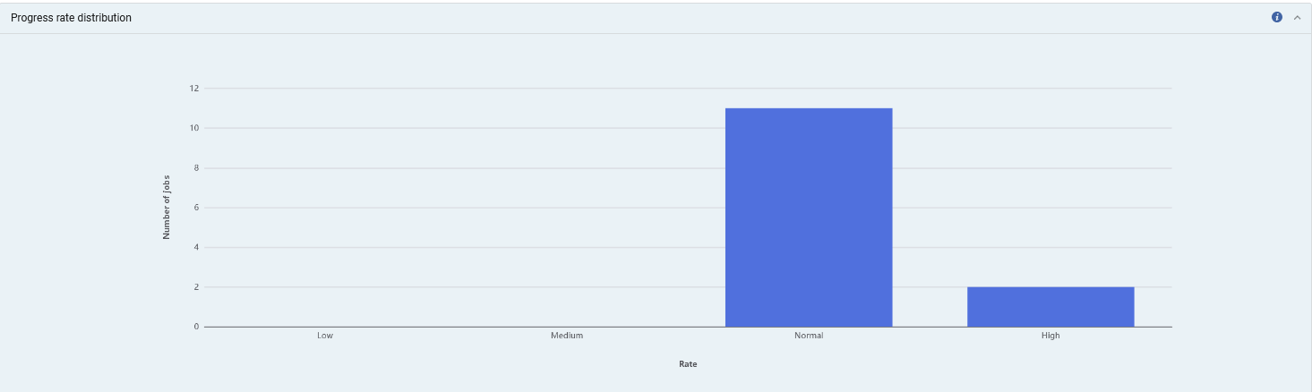
Job Progress Details – a live example (part 4 of 4)
"Progress rate distribution" before and after
Job at 69.81%
Job at 98.96%
11 Normal and 2 High
No change here

Slide 38
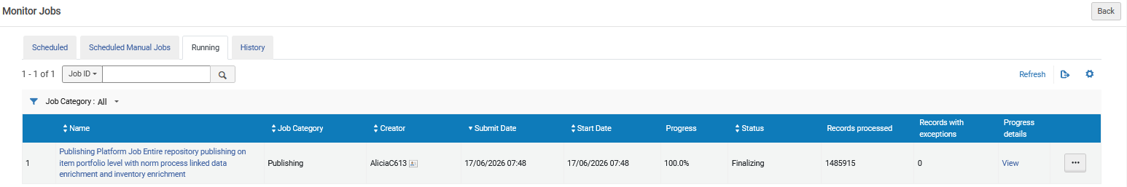
Job Progress Details – a live example (part 4 of 4)
Now it is "Finalizing"

Slide 39
Job Complete

Slide 40
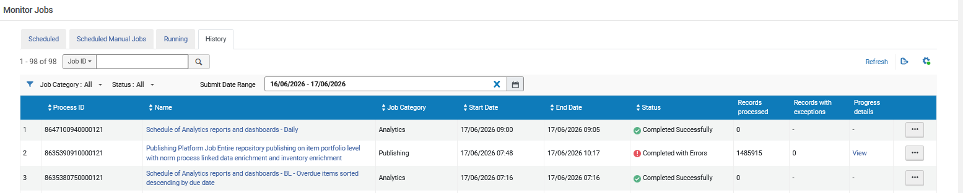
Job Complete
Now it is "Completed"
We are in the "History" tab

Slide 41
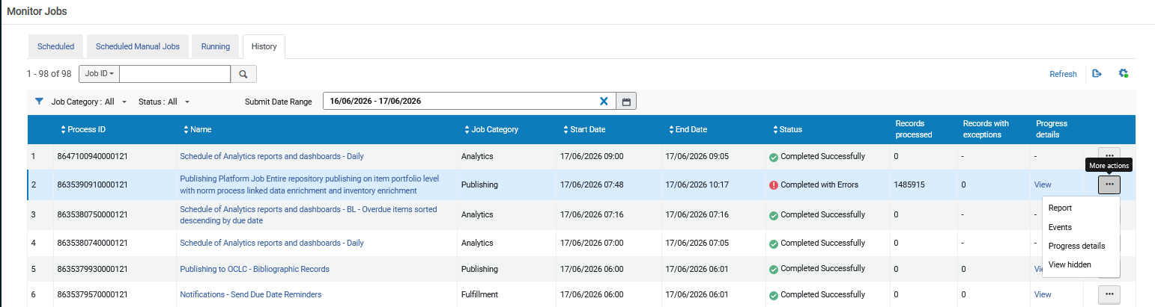
Job Complete
We will view the job report and see why it was "Completed with Errors"
We are in the "History" tab

Slide 42
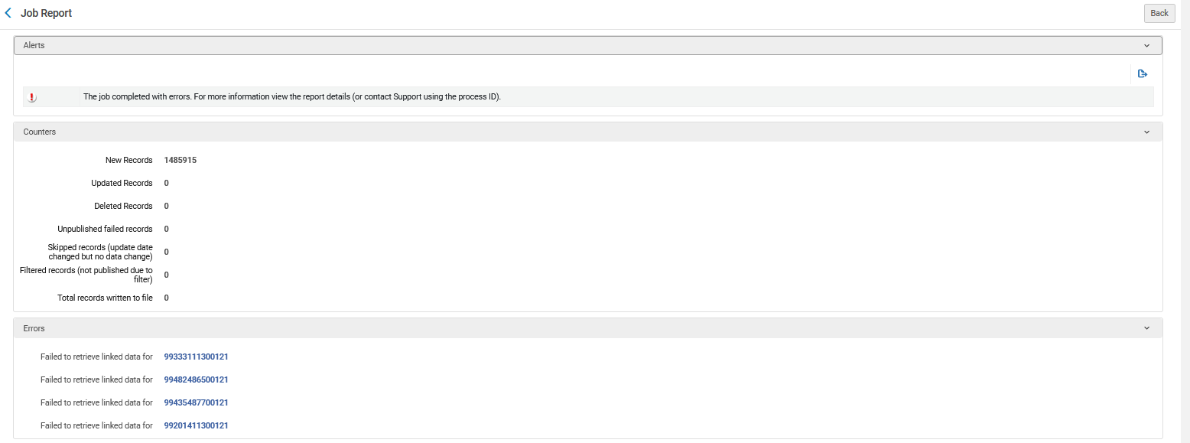
Job Complete
We see (for this specific case) that it was "Completed with Errors" because there were four records for which the publishing job could not retrieve linked data

Slide 43
Job Complete
We can view the final "Progress details" from the "History" tab when the job has finished
The "Progress details" (as previously stated) can be viewed from both the "Running" tab and the "History" tab).
We are in the "History" tab
Now we will again click "View" and see the progress.

Slide 44
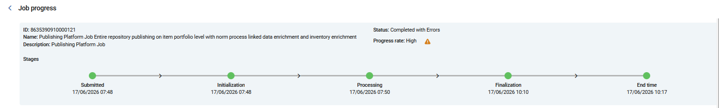
Job Complete
We see the full job progress with five stages:
Submitted
Initialization
Processing
Finalization
End

Slide 45
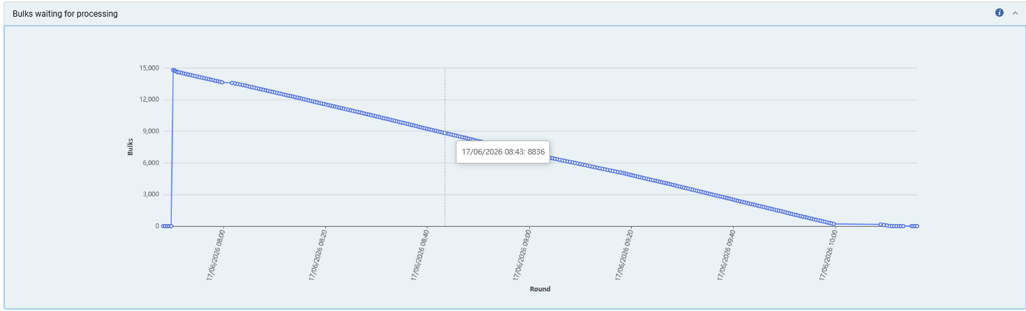
Job Complete
We see the full progress of the "Bulks waiting for processing":
We can hover the mouse over sections of the line to see how many processes there were at each time and see how it decreased.
A beautiful "steady decline" to 0.

Slide 46
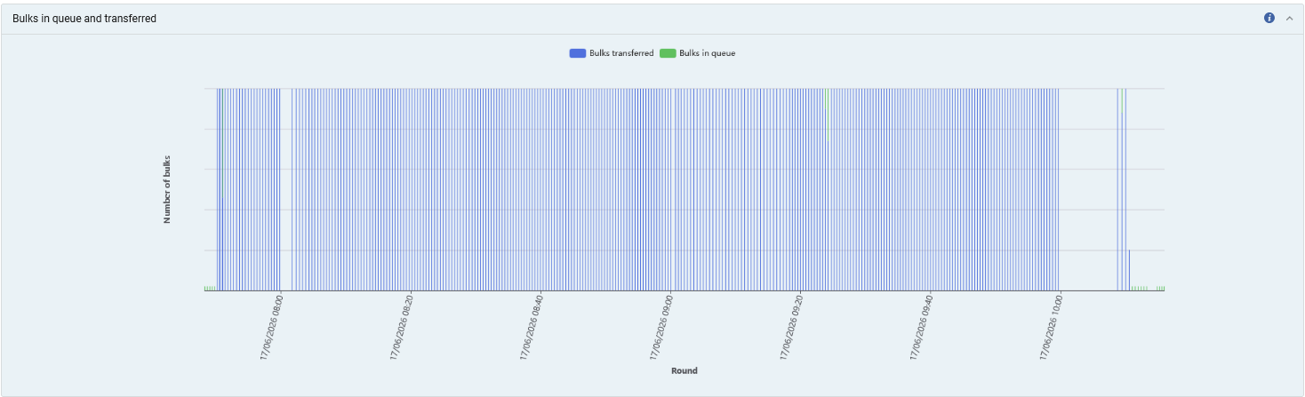
Job Complete
We see that all bulks have been transferred and none are waiting in queue
All bulks are blue meaning they have been transferred and none remain in queue

Slide 47

Job Complete
The "Progress Rate Distribution" has 11 Normal and 2 High (The progress rate distribution for jobs of the same type from the past 3 months.).
11 Normal and 2 High

Slide 48

Yoel Kortick
Yoel.Kortick@clarivate.com
About Clarivate
Clarivate is a leading global provider of transformative intelligence. We offer enriched data,
insights & analytics, workflow solutions and expert services in the areas of Academia & Government, Intellectual Property and Life Sciences & Healthcare. For more information, please visit clarivate.com.
© 2026 Clarivate. All rights reserved
Clarivate and its logo, as well as all other trademarks used herein are trademarks of their respective owners and used under license.

